Slide 1
Chat-Bot with Machine Learning
David Monahan

Slide 2
What is a Chat-Bot?
A Chat-Bot is a program which attempts to generate a response to a user input based on the rules it has been programmed with. Rules are usually simple like change “I” to “You” and repeat back the same line with a question mark e.g. I don’t like Mondays You don’t like Mondays? The primary purpose being to simulate a conversation and in so doing provide a more natural interface for the user.
Adding machine learning to a Chat-Bot is an attempt to use the user inputs to generate new rules.

Slide 3
Machine Learning
A method of data analysis using algorithms to iteratively learn from input data. Has a wide range of uses and applications from pattern recognition to self driving cars.
This project will deal primarily with Supervised and Unsupervised learning algorithms to identify lines of dialogue which are similar or trend towards the same final outcome.
Supervised Learning: is training using examples where the correct outcome is already known. This allows the program to be fine tuned towards the desired responses.
Unsupervised Learning: is training where the outcome is not known and is instead used to try and find patterns or trends within the data.

Slide 4
3 Step Program
Step 1: Implement Rules Based Chat-Bot. For this I will be using the newest fork of AliceBot and AIML2
Step 2: Implement Machine Learning Algorithms. I will be using a mix of supervised and unsupervised learning to generate the desired rules. Unsupervised learning first to find the trends and patterns in conversations and Supervised to refine those patterns to be more efficient.
Step 3: Training and Testing. This involves running various conversation databases, such as the Ubuntu Dialogue Corpus, and testing the program after each run to see how or if it has improved.
Rules Based Chat-Bot
Machine Learning Algorithms
Training and Testing

Slide 5
Work Done So Far
Rules Based Chat-Bot implemented and functional. Features:
Persona implementation, remembers name, age, location etc. of the user.
Pannous Integration, allows it to use the same google search features as mobile based assistants like Siri.
Basic Learning capability, if it returns an obviously wrong response the user can type “incorrect” and what the response should have been. This will be heavily expanded with learning algorithms.
Topic Memory, allows the program to remember what was being referenced when the user uses words like “they” or “it”.
AIML, a system for storing rules and responses which is lightweight and extendable while the program is running. Includes tags to responses to indicate if they use the persona or current topic, references to other responses in the database or require an external program/library such as Pannous to execute correctly.

Slide 6
Work to be done
Machine Learning Algorithms
Implement an Unsupervised Algorithm to classify user inputs and outputs into various groups. These groups will be based on similarity to each other (words used not actual similarity) and how much their responses vary.
A Supervised Algorithm is then applied to classify the resulting groups in accordance to the expected outcome. This will allow the program to narrow down the possible branches that the conversation can take and begin to predict the users intended action based on previous history.
Training and Testing,
Using freely available conversation repositories the bot will then be trained and tested. Testing will be a mix of user feedback and preselected conversations to see how they differ as the program is being trained.
Based on data from testing the Algorithms may be changed or adjusted and then the program trained again. The program may also be trained on the same data set several times over to see how it responds based on its changed rule state.

Slide 7
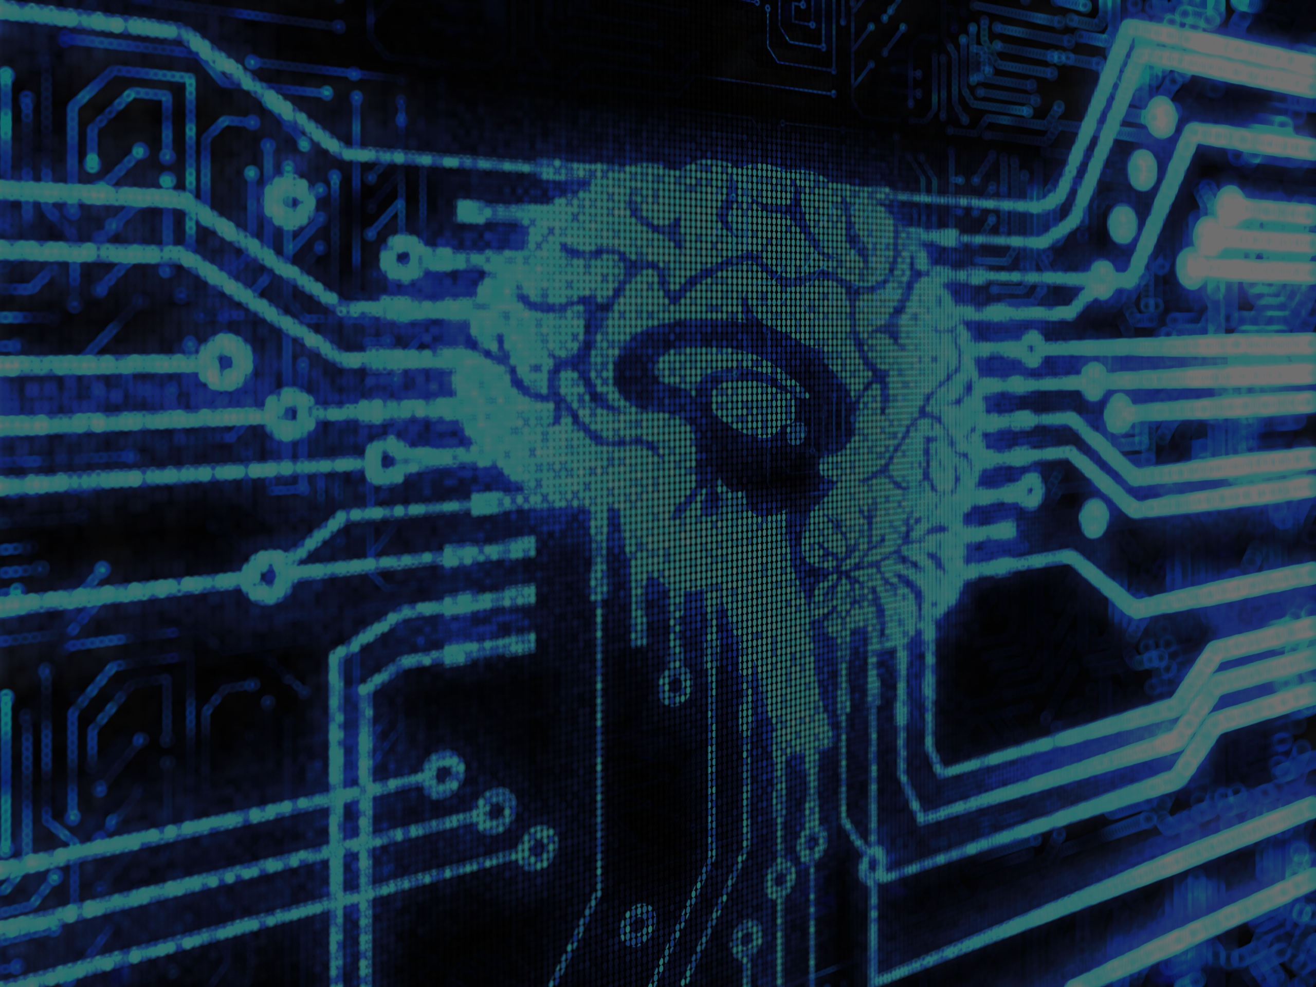
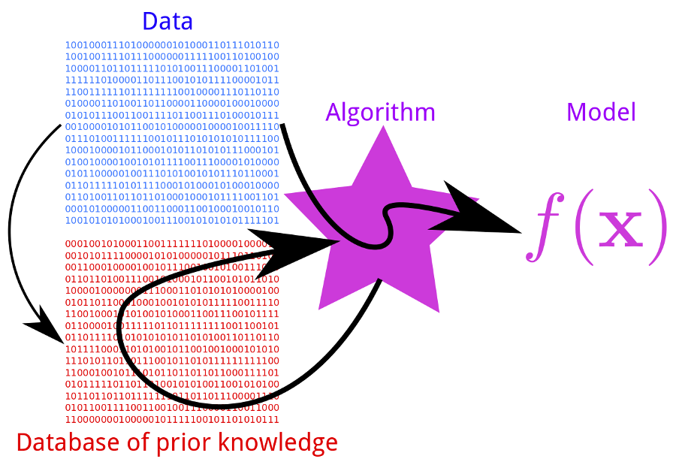
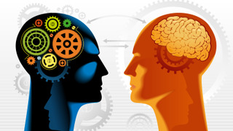
Chat-Bot with Machine Learning
A Chat-Bot which uses Machine Learning Algorithms to modify future behaviour based on past behaviour.
Features Include:
Persona integration, Memories of past conversations and user specific data like name, age, gender.
Pannous, the technology behind personal assistants like Siri.
User Specified Learning, invalid responses can be fixed immediately by the user. Simply tell the program what to say or do instead.
Open design allows for additional features, such as Text-To-Speech and Voice Recognition to be added with very little overheard.
User Input
Machine Learning
History
Applying The Model
User
Open the Cargo Bay Doors HAL
Chat-Bot
I Cannot Do That Dave
User
Incorrect Response
Open the Cargo Bay Doors
David Monahan
Opening the Cargo Bay Doors
Chat-Bot

